Slide 1
Please go to
https://www.dropbox.com/sh/fa68l7ql0irbq04/AADEJCldD6O0E6gFNK6Q-0baa?dl=0
and click ‘Download’ (top right-hand corner)
The PowerPoint in the folder will play the audio; this PowerPoint will not
(this is because PowerPoint files only play audio when the PowerPoint is in the same folder as the audio files!)
© www.SaveTeachersSundays.com 2014

Slide 2
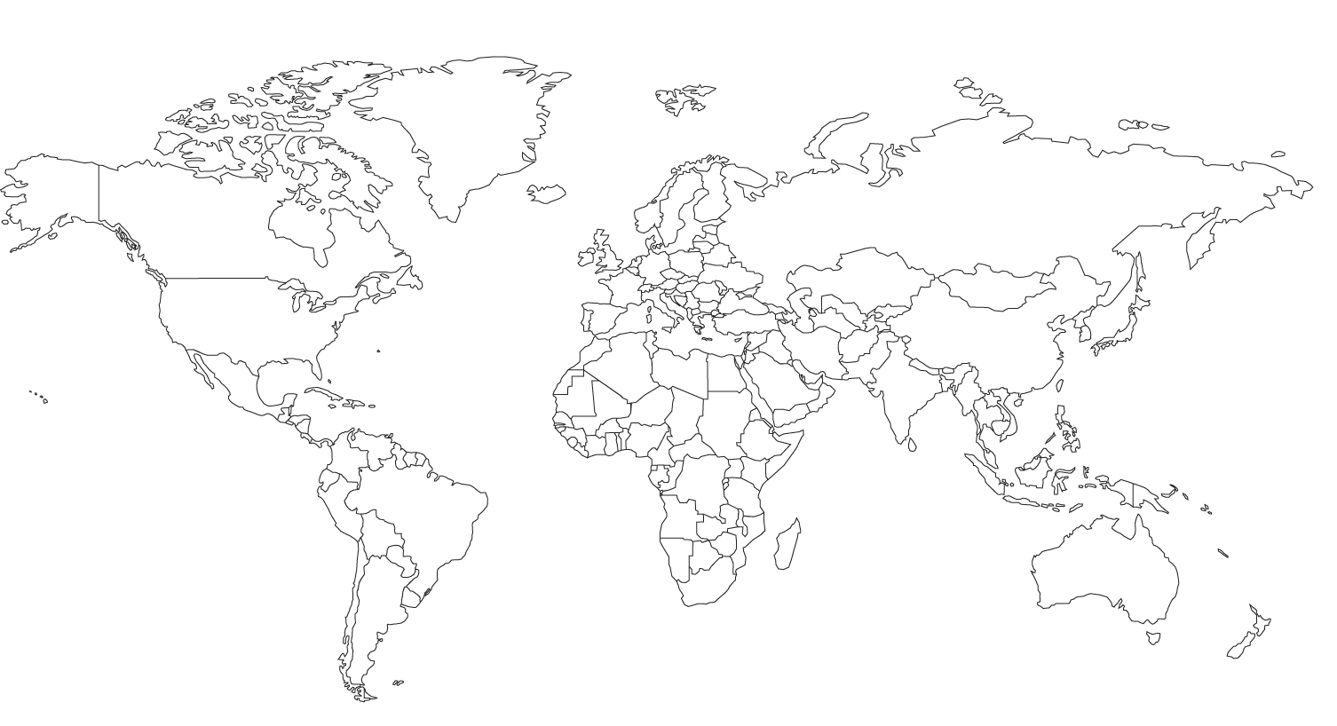
How many Spanish-speaking countries can you remember?
© www.SaveTeachersSundays.com 2014

Slide 3
Greetings
© www.SaveTeachersSundays.com 2014

Slide 4
What is a ‘greeting’?
A greeting is something that we say or do when we meet someone.
Different cultures have different greetings and we use different greetings in different situations.
Can you think of some actions that people use to ‘greet’ each other?
© www.SaveTeachersSundays.com 2014

Slide 5
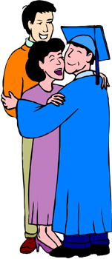
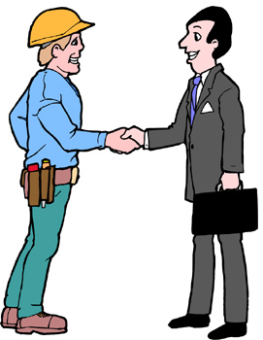
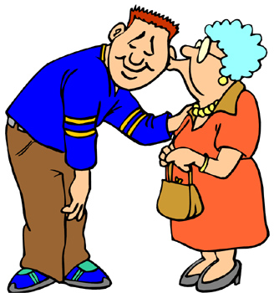
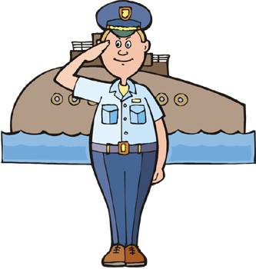
Greetings - Actions
© www.SaveTeachersSundays.com 2014

Slide 6
What is a ‘greeting’?
We can also ‘greet’ people using words
Can you think of some different words or phrases that we use to greet each other in English?
© www.SaveTeachersSundays.com 2014

Slide 7
Greetings in English
Hello
Good morning
Hi
Hey
Good evening
Good afternoon
© www.SaveTeachersSundays.com 2014

Slide 8
Greetings in Different Languages
People who speak different languages use different words to greet each other
Do you know any greetings in any other languages?
© www.SaveTeachersSundays.com 2014

Slide 9
Greetings in Different Languages
(as-salām 'alaykum) السلام عليك
नमस्ते (namaste)
Ciao
Guten Tag
Bonjour
你好 (nǐ hǎo)
今日は (konnichiwa)
© www.SaveTeachersSundays.com 2014

Slide 10
Greetings in Spanish - Actions
Spanish people often kiss on the cheeks to greet each other
© www.SaveTeachersSundays.com 2014

Slide 11
Greetings in Spanish - Words
Let’s watch a video of some Spanish greetings
http://www.bbc.co.uk/schools/primarylanguages/spanish/all_about_me/videos/
Can you guess what each of the greetings means?
© www.SaveTeachersSundays.com 2014
Notes:
Unlike in English, Good night / Buenas tardes can be used as a greeting

Slide 12
Greetings in Spanish - Words
English Spanish
Hello
Hola
Good morning
Buenos días
Good afternoon / good evening
Buenas tardes
Good night
Buenas noches
Goodbye
Adiós
© www.SaveTeachersSundays.com 2014
Notes:
Unlike in English, Good night / Buenas tardes can be used as a greeting

Slide 13
Source of images:
World map - http://www.freeusandworldmaps.com/html/World_Projections/WorldPrint.html
Kiss on cheeks - http://pixabay.com/en/kiss-love-couple-man-woman-307066/
All other images www.clipart.com or www.clker.com
© www.SaveTeachersSundays.com 2014

